Slide 1
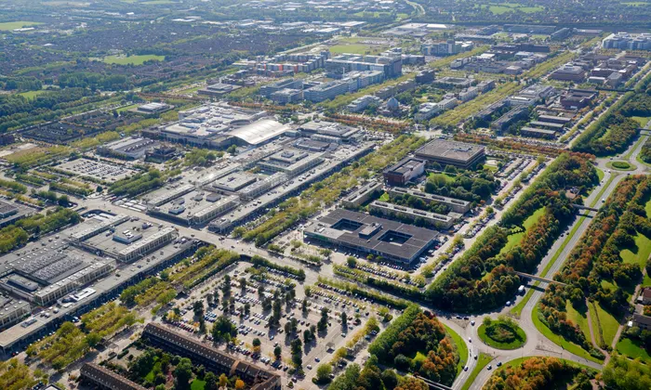
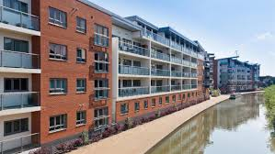
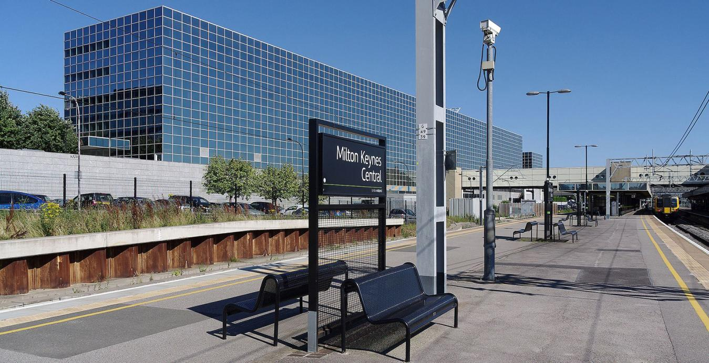
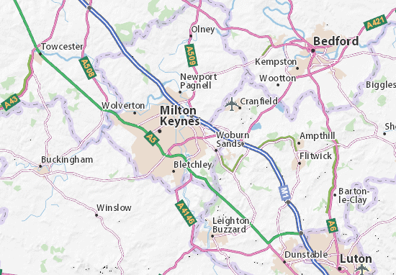
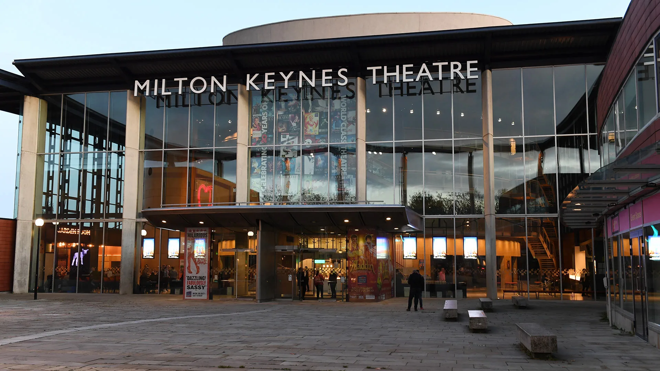

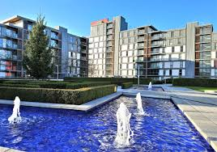
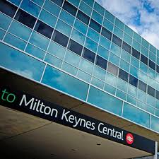
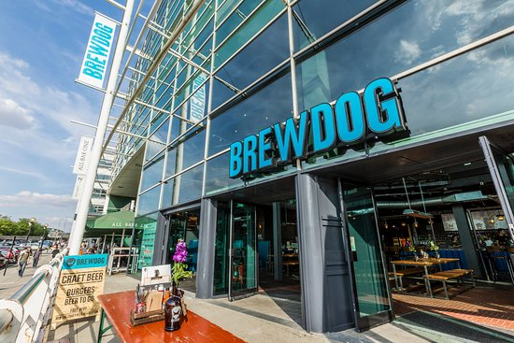
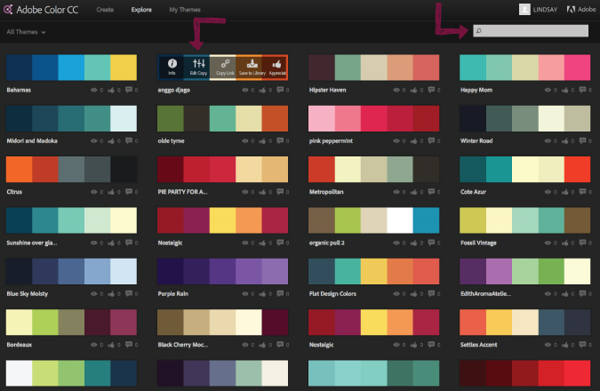
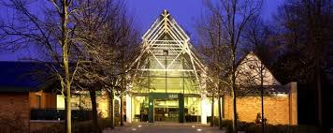

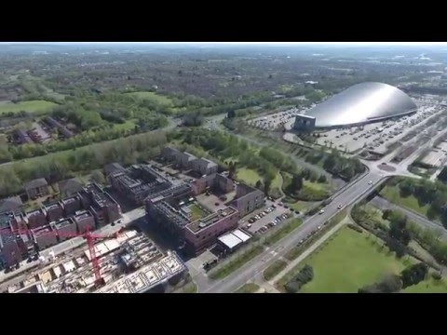
The Milton Keynes central will be a good tourist attraction as many people will shop there.
This is the Brew Dog restaurant and bar in Milton Keynes which teenagers will go to when they are hungry.
Map of Milton Keynes
Video showing around Milton Keynes and the tourist attractions
(Double click)
Milton Keynes
Lithos Pro Regular
Stables theatre in Milton Keynes
Milton Keynes
Harlow Solid Italic
Milton Keynes
Baskerville Old Face
I may use some of these buttons to allow the user to navigate through the Interactive multimedia product.

